Slide 1

Aviation accident analysis in the US
“ How can we reduce aviation accidents by identifying and mitigating key risk factors? ”

Slide 2
Key:
Slide 3 : Introduction - Saving lives through data
Slide 4 : Key findings - What was discovered?
Slide 5 : Visualization 1 - Top 5 states by aviation accident count
Slide 6 : Visualization 2 - Fatal accidents per year (1948-2022)
Slide 7 : Visualization 3 - Total fatalities by weather condition
Slide 8 : Recommendations - How to act
Slide 9 : Conclusion - A safer future

Slide 3
Saving lives through data
Aviation accidents are preventable. This project uses historical data to find where and why they happen, helping the FAA, manufacturers, and consultants make flying safer.
By identifying states with the highest accident rates, weather conditions linked to facilities and risky flight phases, the FAA can prioritize resources (e.g., inspections, training programs) to prevent future incidents, ultimately enhancing aviation safety nationwide

Slide 4
What was discovered?
US States; California, Texas, Florida, Alaska, and Arizona are the top 5 states that have the most accidents.
In terms of fatal accidents, they peaked in 1982 with 15 incidents recorded.
Total fatalities by weather conditions showed VMC weather had up to 3 times the number of fatalities IMC weather recorded.
Below are the images to visualize what was discovered.

Slide 5
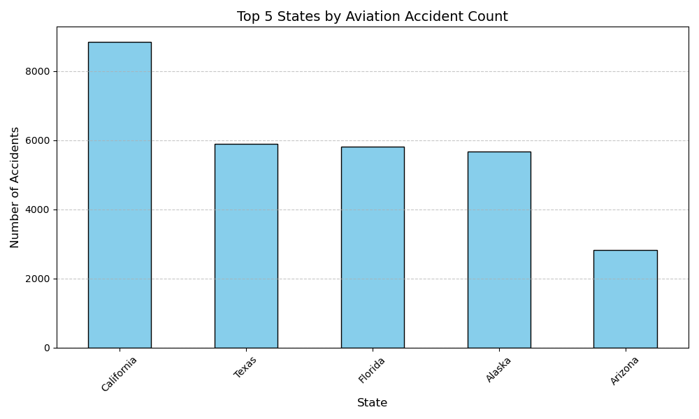

Slide 6
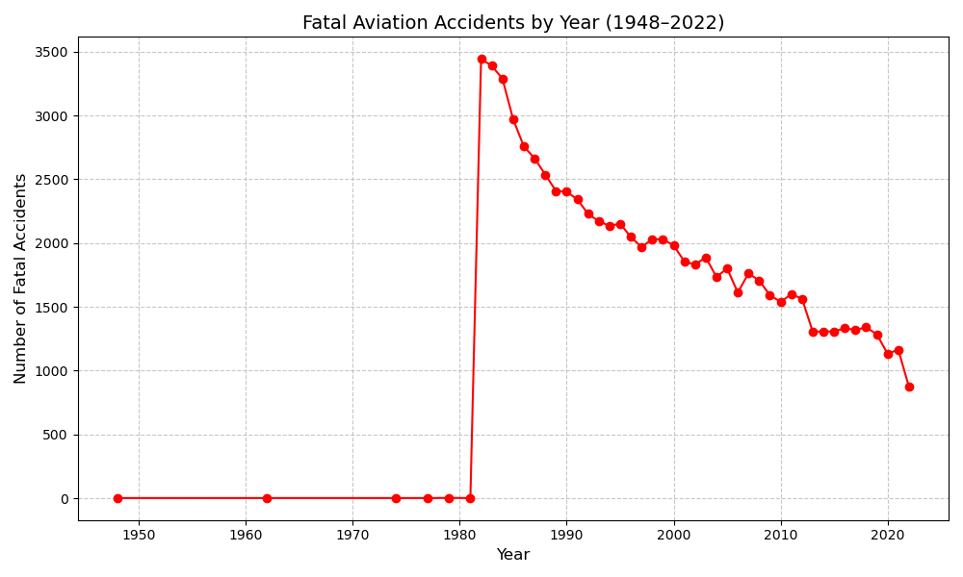

Slide 7
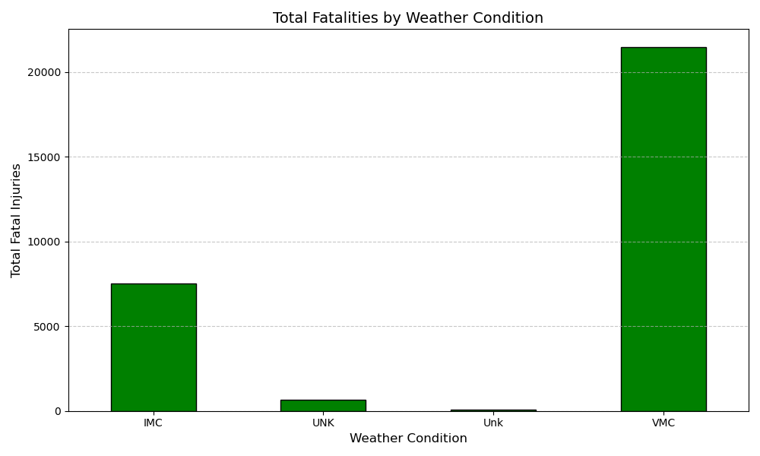

Slide 8
How to act
For the FAA: They need to boost inspections and training in the states of California, Texas, Florida, Alaska, Arizona.
The Consultants: They ought to study 1982 accidents for lessons on weather or pilot error.
The Manufacturers: They need to improve navigation tools to help cope with the IMC conditions.

Slide 9

A Safer Future
By targeting high-risk states, learning from history, and tackling weather challenges, we can cut accidents and save lives.
In this way, we can reduce aviation accidents by identifying and mitigating key risk factors.

Slide 10
Presentation by : Alvin Kipkurui Ngeno

